Slide 1

Blockchain
Sunitha R
Department of Computer Science and Engineering

Slide 2

Blockchain
DNS
Sunitha R
Department of Computer Science and Engineering

Slide 3
Blockchain
Blockchain-Based DNS Security Platform
The Domain Name System (DNS) is mainly designed to resolve a host name query to an IP address. Internet users need to have domain names, such as www.packtpub.com, but the internet needs an IP address to route the request to the desired destination.
This way, the DNS becomes the phonebook of the internet and allows everyone to use it globally at the same time it also leaves a high possibility of it getting misused.

Slide 4
Blockchain
DNS
Anti-spam: Some DNS mechanisms, including Sender Policy Framework (SPF) and DomainKeys Identified Mail (DKIM), ensure only a predefined list of domains should be allowed to send emails on behalf of a specific organization. These mechanisms are effective if the DNS in the organization is working properly.
Load sharing: DNS services can optimize the server infrastructure by load sharing the traffic of highly utilized servers with other Underutilized servers.
Privacy: DNS services ensure the privacy of an organization's namespace information by masking addresses with different names, depending on whether they are accessed from inside or outside of the network, helping to achieve stronger network security.

Slide 5
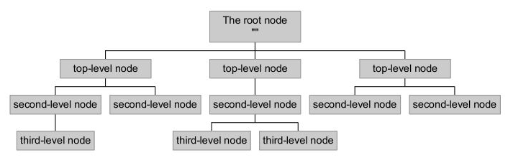
Blockchain
Understanding DNS components
Namespace
A namespace is a structure of the DNS database. It is represented in the form of an inverted tree with its root node at the top. Each node in the tree has a label and the root node has a null label.

Slide 6
Blockchain
Name Servers
Name servers are responsible for storing information about the namespace in the form of zones.
There can be multiple name servers and ones that load a complete zone are said to be authoritative for the zone
There are two main types of name servers:
Authoritative servers
Caching servers:

Slide 7
Blockchain
Name Servers
Authoritative name server: It provides responses to DNS queries. It is responsible for delivering original and definitive answers to each DNS query. There can be two types of authoritative name servers:
Master server (primary name server): It stores the original copies of all zone records. An administrator can only make changes to the master server zone database.
Slave server (secondary name server): A slave server keeps a copy of master server files. It is used to share DNS server load and to improve DNS zone availability.

Slide 8
Blockchain
Name Servers
Caching name server: It brings the name service closer to the user and improves overall name lookup performance.
It also provides a comprehensive mechanism for providing private namespaces to local users, by allowing users to obtain all names mapping from local caching.

Slide 9
Blockchain
Resolver
The name resolver is required to find out the name and IP address of the name servers for the root zone.
The root name servers store information about top-level zones and direct servers in whom to contact for all top-level domains (TLDs).
The resolver basically breaks the name into its labels from right to left. The first component, the TLD, is queried using a root server to obtain the designated authoritative server.

Slide 10
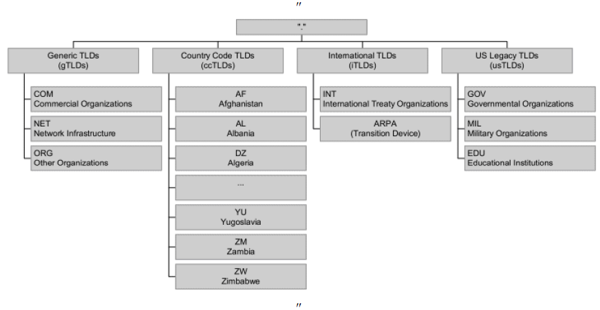
Blockchain
Current TLD structure

Slide 11
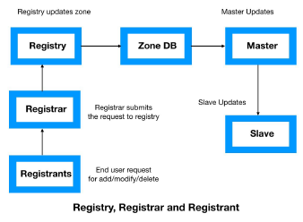
Blockchain
Registries, registrars, and registrants

Slide 12
Blockchain
DNS records
DNS records are mapping files that associate with DNS server whichever IP addresses each domain is associated with, and they handle requests sent to each domain.
MX records: These records identify the servers that can exchange emails. A priority is always associated with each of the records, so the user can choose the primary and backup mail servers.
TXT records: These records deliver a method to expand the information provided through DNS. This text record stores information about the SPF that can identify the authorized server to send email on behalf of your organization.

Slide 13
Blockchain
DNS records
CNAME: CNAMEs are essentially domain and subdomain text aliases to bind traffic. They indicate that the Secure File Transfer Protocol (SFTP) server is on the same system as the mail server. CNAME plays an important role, particularly when the server is not under organizational control such as a hosted or managed web server.
PTR records: These records provide the reverse binding from addresses to names. PTR records should exactly match the forward maps.

Slide 14
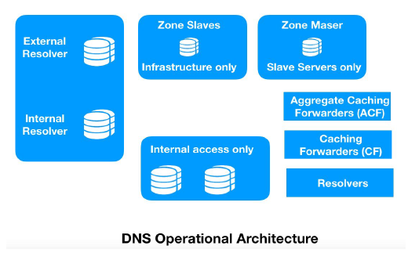
Blockchain
DNS Architecture

Slide 15
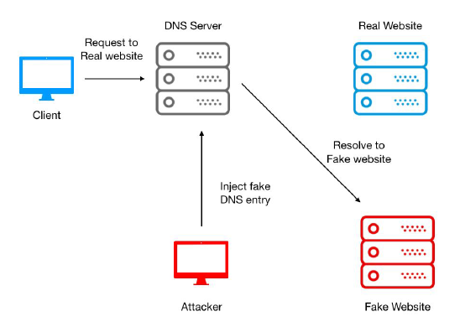
Blockchain
Challenges with current DNS

Slide 16
Blockchain
DNS spoofing
DNS cache poisoning: An attacker can take advantage of cached DNS records and can then perform spoofing by injecting a forged DNS entry into the DNS server. As a result, all users will now be using that forged DNS entry until the time the DNS cache expires.
Compromising a DNS server: A DNS server is the heart of the entire DNS infrastructure. An attacker can use several attack vectors to compromise a DNS server and can provide the IP address of a malicious web server against each legitimate DNS query.
Man-in-the-middle (MITM) attack: In this type of attack, a threat actor keeps listening to conversations between clients and a DNS server. After gathering information and sequence parameters, it starts spoofing the client by pretending to be the actual DNS server and provides the IP addresses of malicious websites.

Slide 17
Blockchain
Blockchain-based DNS solution
DNSChain is one of the most active projects to transform the DNS framework and protect it from spoofing challenges.
DNSChain is a blockchain-based DNS software suite that replaces X.509 public key infrastructure (PKI) and delivers MITM proofs of authentication. It allows internet users to set a public DNSChain server for DNS queries and access that server with domains ending in .bit.
X.509 PKI replacement
X.509 is a standard framework that defines the format of PKI to identify users and entities over the internet.
MITM-proof DNS infrastructure
This uses a public key pinning technique to get rid of the MITM attack problem. Public key pinning specifies two pin-sha256 values; that is, it pins two public keys (one is the pin of any public key in the current certificate chain and the other is the pin of any public key not in the current certificate chain).

Slide 18
Blockchain
Supplementary readings
https://ieeexplore.ieee.org/document/8647279
https://www.researchgate.net/publication/339062224_A_Brief_Review_of_Blockchain-based_DNS_Systems

Slide 19
THANK YOU
Prof.Sunitha R
Department of Computer Science and Engineering
sunithar@pes.edu

